Slide 1
Storm Center
Matthew del valle-College Academy at Broward College central-Java
Connor Mccarthy- -College Academy at Broward College central- UI/Graphics
Summer 2015

Slide 2
Why?
In order to better inform the customers about Florida’s weather patterns, we set out to create an application to enhance the exhbit.

Slide 3
Storm Center-Overview
Six Activities
Main Page
Fun Tricks
Omniglobe
Plasma Ball
Storm Info
Quiz

Slide 4
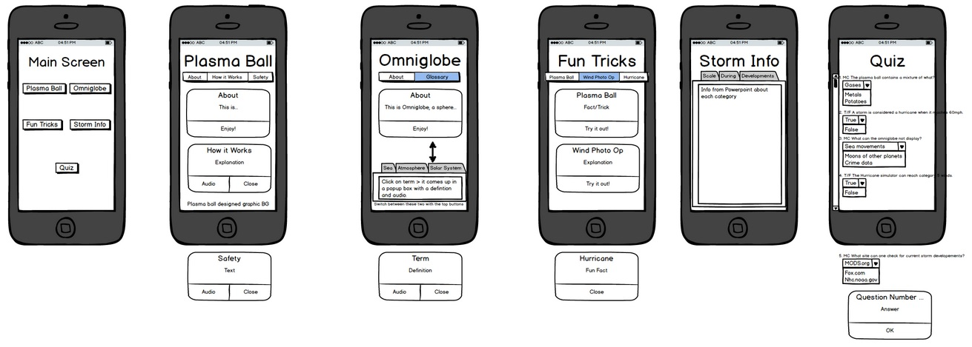
Mockup

Slide 5
Demo

Slide 6
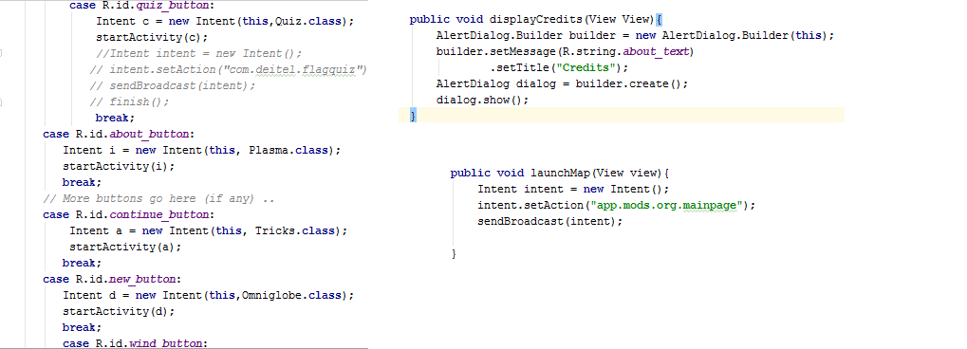
Main Page Java Code

Slide 7
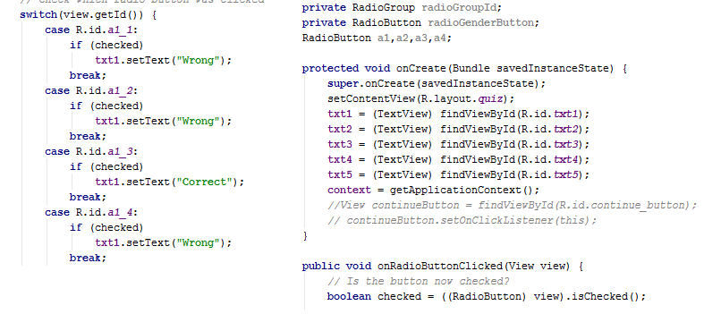
Quiz Activity Java Code

Slide 8
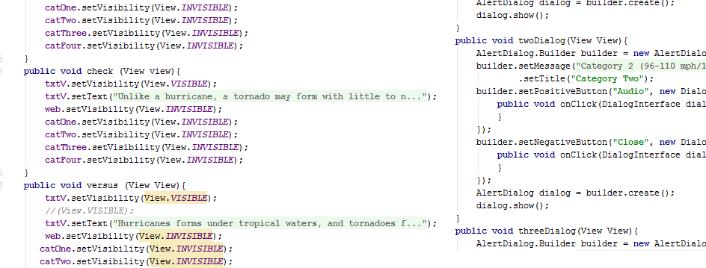
Storm Info/Omniglobe Code

Slide 9
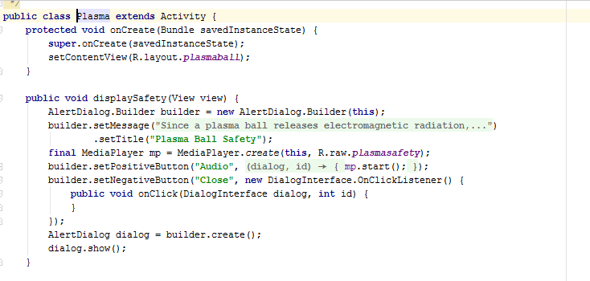
Plasma Ball Activity/Fun Tricks Code

Slide 10
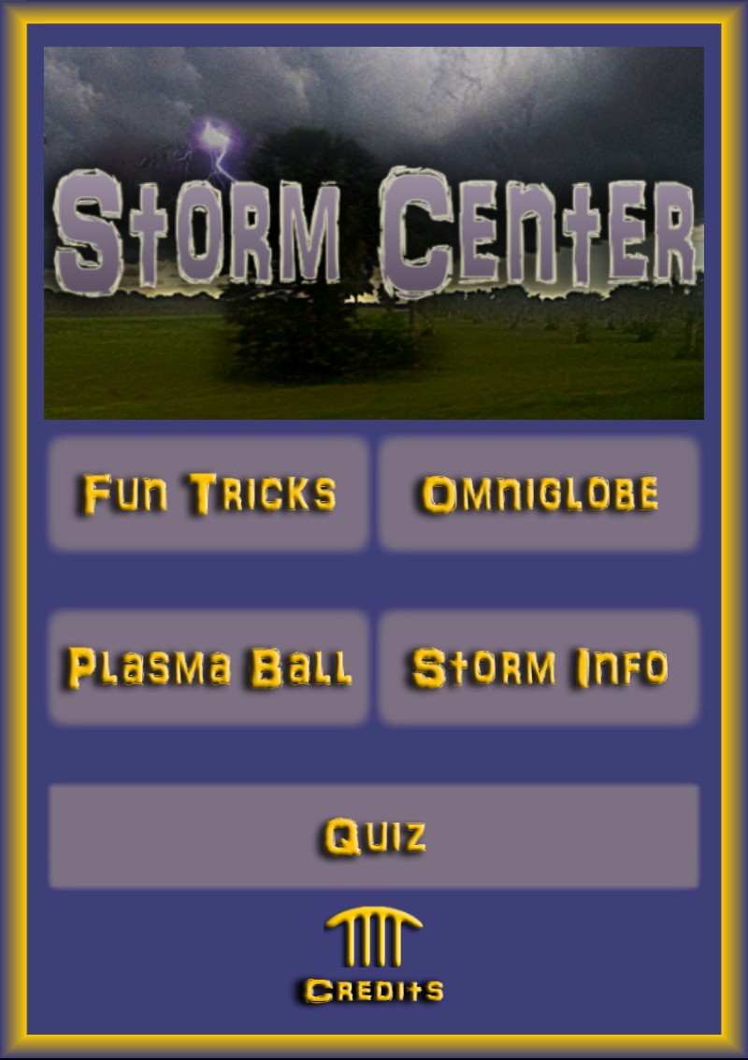
User Interface: Main Page

Slide 11
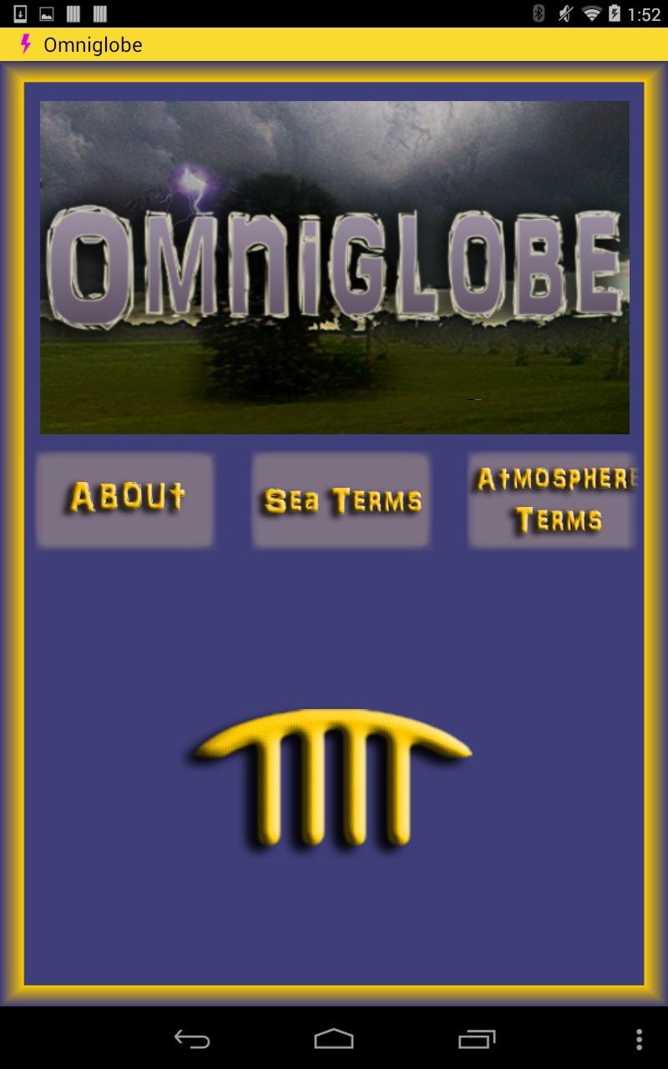
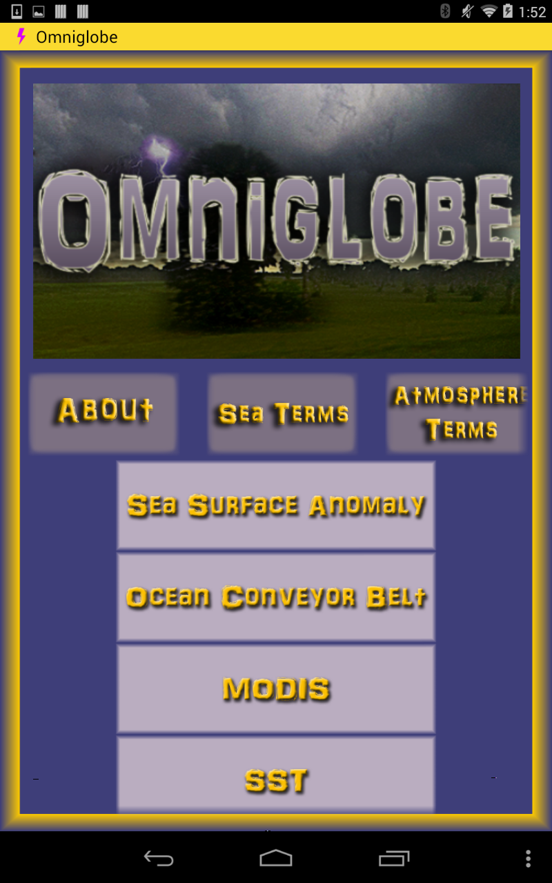
Omniglobe UI

Slide 12
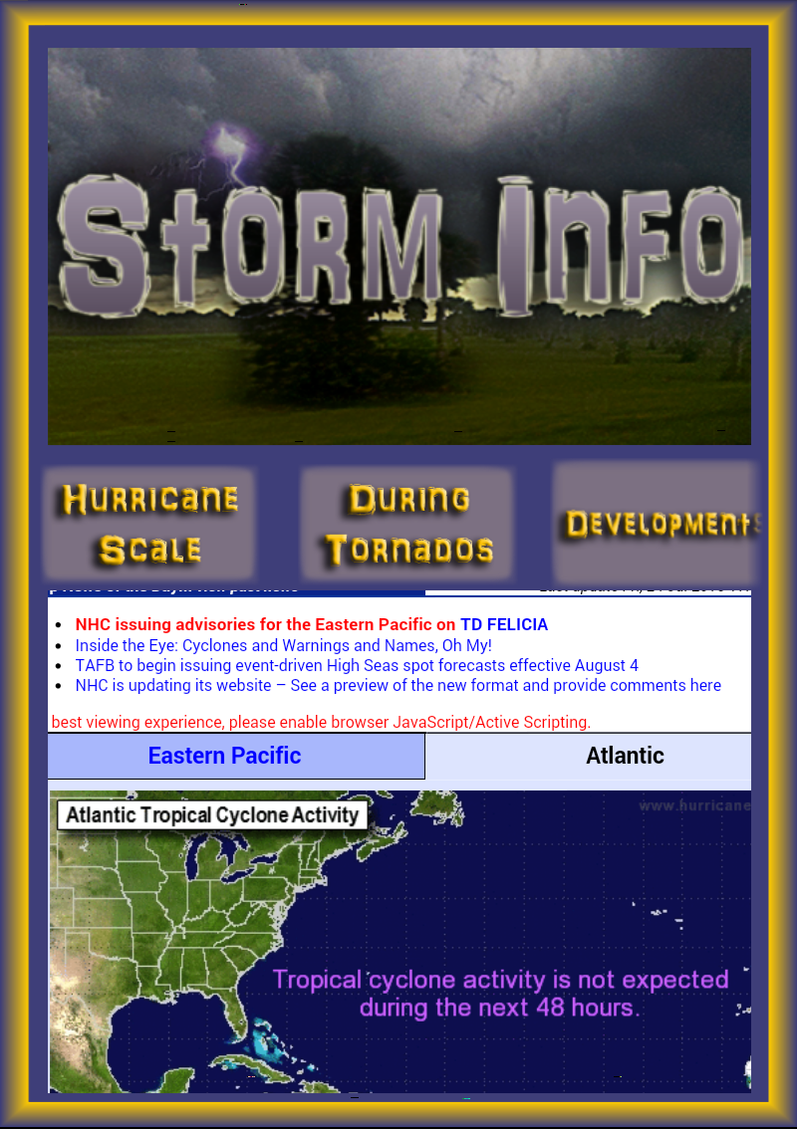
Storm Info UI

Slide 13
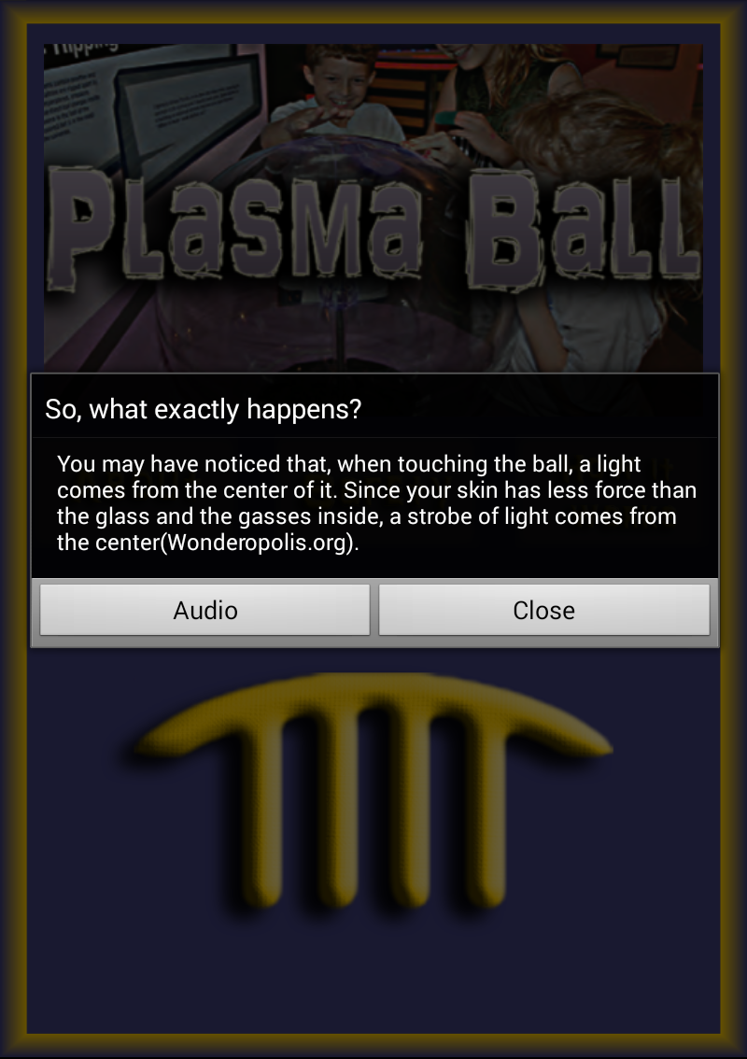
Plasma Ball w/ dialog

Slide 14
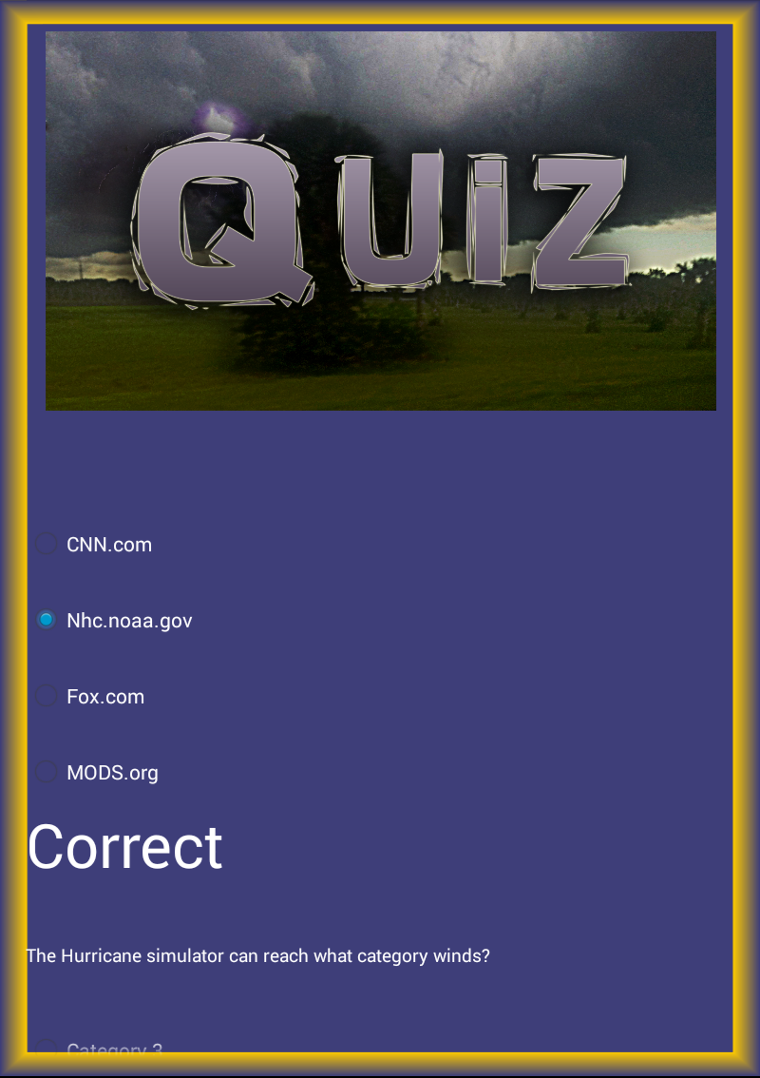
Quiz UI

Slide 15


Graphics w/ Photoshop
Title Screens

Slide 16


Graphics w/Photoshop
Buttons

Slide 17

Video

Slide 18
Thanks to…
Florida Atlantic University
Museum of Discovery and Science
United Way of Broward County
Sudoku game code from Hello Android by Ed Burnette
College Academy @ Broward College Central.

Slide 19
Q/A
Ask away!

Slide 20
The End
Thank you for your time!

